Slide 1
Beyond Risk: A Measure of Distribution Uncertainty
Tao Lu, Lihong Zhang, Xiaoquan (Michael) Zhang, Zhenling Zhao

Slide 2
Introduction
Uncertainty:
Outcome uncertainty: unknown outcome but known distribution (risk)
Distribution uncertainty: unknown outcome and unknown distribution (ambiguity)
Ellsberg’s Paradox:
Urn A: 50 red balls; 50 blue balls
Urn B: 100 balls; distribution of red & blue balls is unknown
Decision: when bet on red balls, individuals choose Urn A; when bet on blue balls, individuals choose Urn B
Research Gap:
Current empirical research focus on environments where outcome uncertainties are quantifiable and well defined, often neglecting scenarios where the probabilities of outcomes are uncertain
Limited measure of ambiguity

Slide 3
Introduction
A Case in OLS Regression
BLUE Estimator: normality assumption is needed to have unbiased estimates of standard errors
Ambiguity measure: can estimate how much the real distribution deviates from the assumed distribution
If there is no deviation, then estimates of SE are trustworthy
When the deviation is large because of ambiguity, CI and p-values are no longer trustworthy
Wooldridge (2012, p. 767) warns: “A more serious problem with the CLT argument is that it assumes that all unobserved factors affect y in a separate, additive fashion. Nothing guarantees that this is so. If u is a complicated function of the unobserved factors, then the CLT argument does not really apply.”
Research Question: How to measure distribution uncertainty (ambiguity)?

Slide 4
Literature
Ambiguity in Theoretical Models:
Employ subjective expected utility (SEU) theory to explore ambiguity aversion
Questionnaire measures:
Directly investigate various uncertainty scenarios
Empirical measures:
Analyst disagreement (Anderson et al, 2009)
CBOE VIX (Williams, 2015)
Entropy (Gong et al, 2018 and Hansen and Sargent, 2001)
This study:
Hellinger distance (HD)
Measure the distance between the actual distribution and the distribution of outcomes predicted by a reference model (the degree to which actual data deviates from the normality assumption)

Slide 5

Literature
Common Limitations:
Discerning ambiguity from risk is challenging
Analyst disagreement:
Dispersion of forecasts correlates strongly with stock price volatility
Accommodate both forecasters’ subjective opinions regarding ambiguity and the objective ambiguity emanating from the market
CBOE VIX:
Incorporate information related to both risk and ambiguity
From a theoretical standpoint, the VIX lacks a direct connection to distribution uncertainty
℧ (mho) measure:
Quantify the uncertainty associated with the distribution of a financial asset’s returns
φ(r) represents the PDF of return r
Rely on high frequency transaction data to calculate the distribution of distribution

Slide 6

Literature
Common Limitations:
Discerning ambiguity from risk is challenging
Relative entropy (KL divergence):
Quantify the disparity between a reference model and alternative models
Zero probability set of p1 must align with the set of p2, llimiting its applicability in addressing extreme events, such as black swan moments

Slide 7

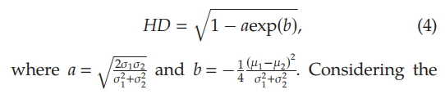

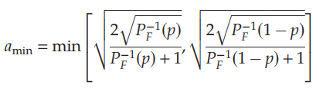

Hellinger Distance
Definition (between two normal distributions):
Determining critical values under certain confidence level:
Suppose the F-test of equality of variances in two samples with same size: $F=\frac{σ_{1}^{2}}{σ_{2}^{2}}, d_{1}=d_{2}=N−1$
CDF of F-distribution:
For any given p-value, the corresponding minimum and maximum values are:
$$F_{min}=P_{F}^{−1}\left(p\right) F_{max}=P_{F}^{−1}(1−p)$$
And we can rewrite:
$$α=\sqrt{\frac{2\sqrt{F}}{F+1}}$$

Slide 8




Hellinger Distance
Definition:
Determining critical values under certain confidence level:
Suppose the Welch’s t-test:
CDF of t-distribution:
For any given p-value, the corresponding minimum and maximum values are:
$$t_{min}=P_{t}^{−1}\left(p\right) t_{max}=−P_{t}^{−1}\left(p\right)$$
And we can rewrite:
$$b=−\frac{1}{4}\frac{t^{2}}{N}$$

Slide 9

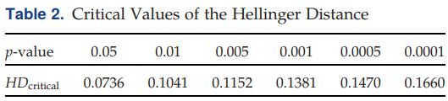


Hellinger Distance
Definition:
Determining critical values under certain confidence level:
After calculating $a_{min}$ and $b_{min}$, the critical value of HD:
The set of critical values depends solely on the sample size, without being constrained by any specific attribute of the sample
A sample size of n = 250:
General Form:

Slide 10



Application
Regression:
$$Y=Xβ+ε$$
Important assumption: $ε|X\sim N(0,σ^{2}I)$
Simulation:
30 years, 250 days in each year
Data generation process: $X_{t}\sim N\left(170,10\right), ε_{t}\sim N\left(0,5\right), Y_{t}=2X_{t}+ε_{t}$
The other sample: randomly select 6 / 30 years
half follow: $ε_{yt}\sim N(50,10)$ the other half follow: $ε_{yt}\sim N(−50,10)$
Run the regression $Y_{t}=β_{t}X_{t}+ε_{t}$ cumulatively (using all data up to year t for each year), calculating $e_{t}$
Use $e_{t}$ to calculate HD
 | X | Y
t = 1 | X1 | Y1
t = 2 | X2 | Y2
... | ... | ...
t = 7500 | X7500 | Y7500

Slide 11
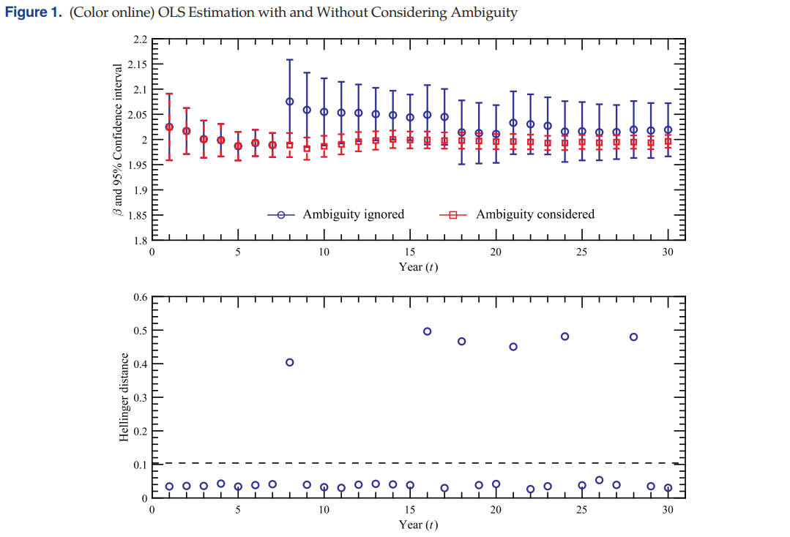
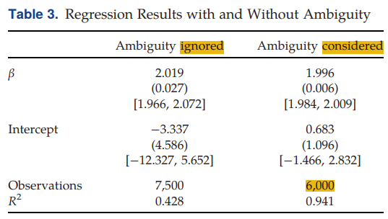
Application
Ambiguity considered: exclude the ambiguous years from the regressions up to year t for each year
Ambiguity ignored: include
Notes:
SE in the bracket

Slide 12

Application in Financial Market
Data:
Daily S&P 500 return in excess of the one-month Treasury rate
HD calculation:
Market-wide: using residuals from ARMA(1, 1) regression
Using historical 250 trading days’ daily returns up to time t
Rolling regression
Reference distribution: normal distribution with the same mean and variance
Notes:
SE in the bracket

Slide 13
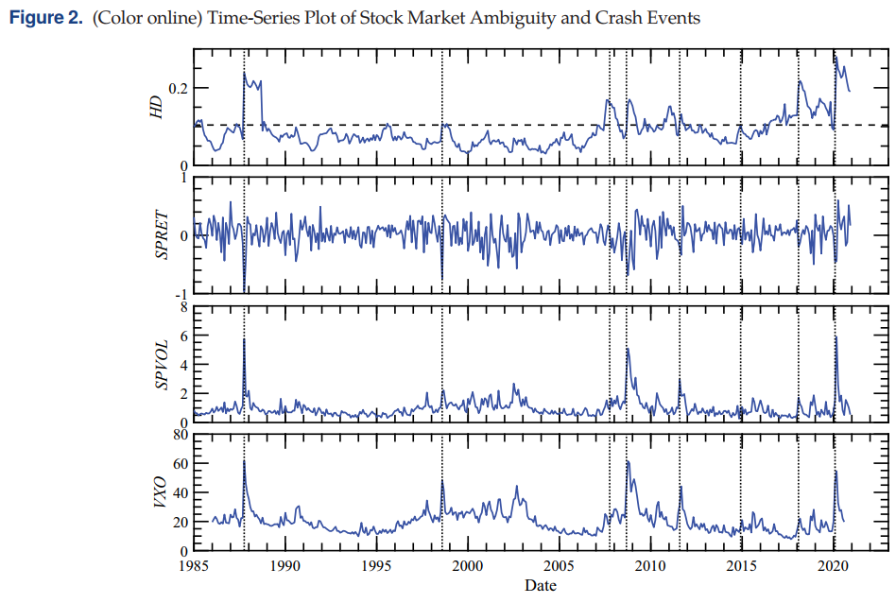
Application in Financial Market
SPRET: mean of daily returns in month t
SPVOL: SD of daily returns in month t
VXO: implied volatility of an option contract on the S&P 100 index
Notes:
SE in the bracket

Slide 14
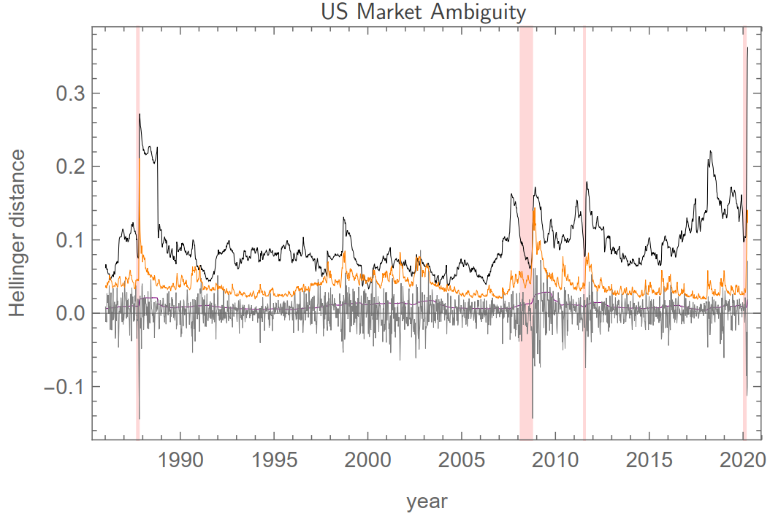
Application in Financial Market
Notes:
SE in the bracket

Slide 15

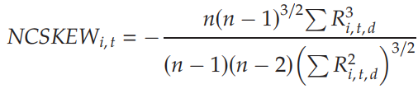
Application in Financial Market
Prediction Power:
HD calculation:
Firm-level: using residuals from cross-sectional regression
Rolling window: 250 trading days
Reference distribution: normal distribution with the same mean and variance
Dependent variable: proxy for occurrence of financial crashes
Negative coefficient of skewness (NCSKEW)
Calculate on a yearly basis using daily returns data
An increase in NCSKEW corresponds to a firm being more “crash prone” or having a more left-skewed distribution

Slide 16
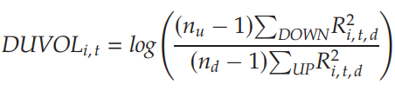

Application in Financial Market
Prediction Power:
HD calculation:
Firm-level: using residuals from cross-sectional regression
Rolling window: 250 trading days
Reference distribution: normal distribution with the same mean and variance
Dependent variable: proxy for occurrence of financial crashes
“Down-to-up” volatility (DUVOL)
Prediction (annual panel data):
t: year t

Slide 17
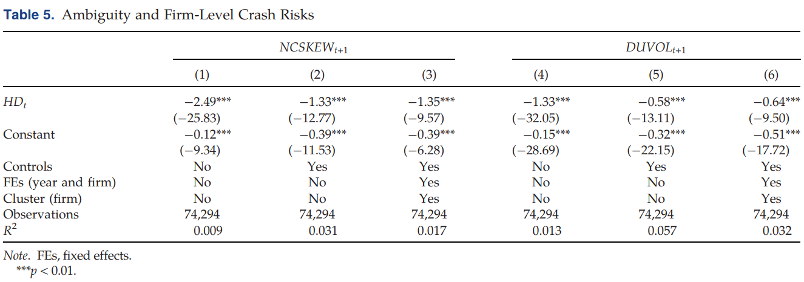
Application in Financial Market
Result:
Interpretation:
Corporate managers have discretion over information disclosure and are incentivized to strategically withhold negative information while hastening the release of positive information
This asymmetric disclosure behavior results in a degree of positive skewness in returns
If a firm exhibits greater ambiguity or opaqueness, managers are more inclined to adopt this disclosure strategy,

Slide 18
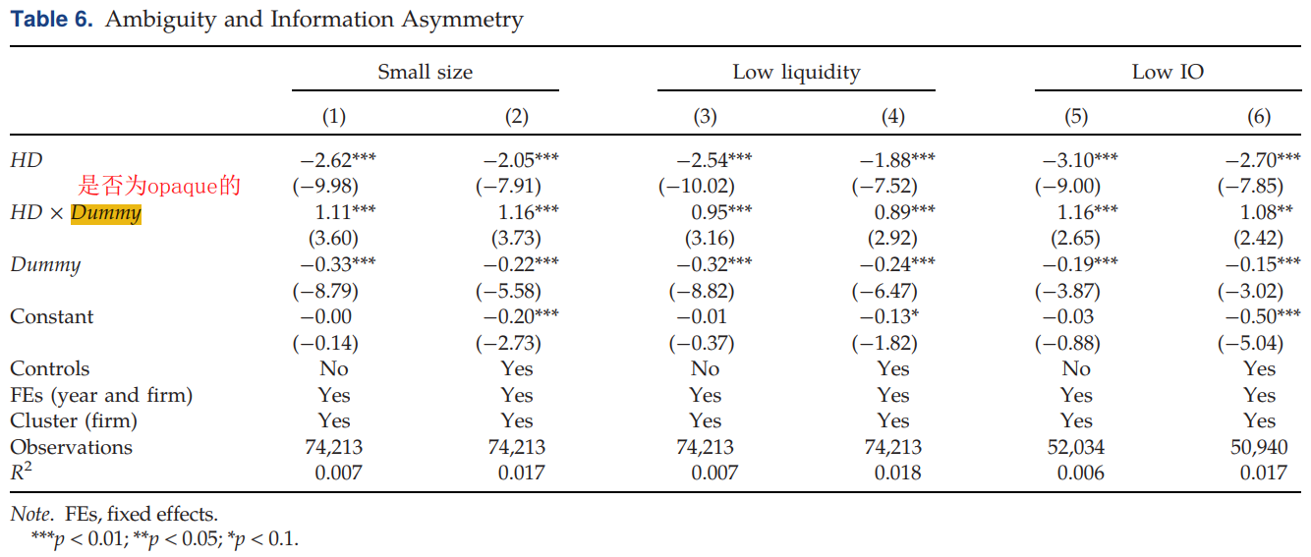
Application in Financial Market
Opaque firm: the firm exhibits small size, low liquidity, or low institutional ownership (IO) based on median values for each month.

Slide 19
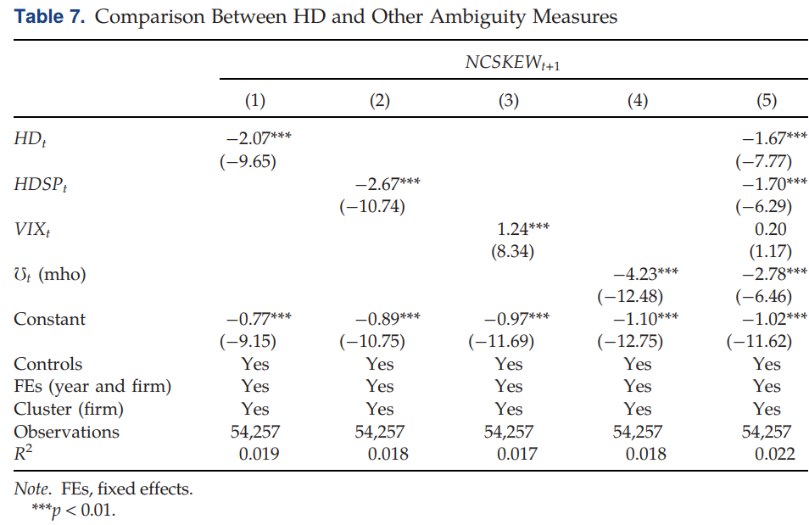
Additional Analysis
Other measures of uncertainty
Various time horizon of crash risk measures (monthly, quarterly, semiannual)

